Slide 1
Tonight’s class
Announcements
Quiz
Designing Interfaces
Subclassing
Template Method Pattern
Iterator Pattern
Visitor Pattern

Slide 2
Announcements
Project class diagrams
Course evaluations
Next week

Slide 3
Quiz

Slide 4
Designing interfaces
You need to consider many circumstances when designing interfaces (interfaces the concept, not the Java construct).
You can have a class provide an interface of sorts by having methods that are protected that need to be overridden or called by a child class.
Ex. Observable.setChanged

Slide 5
Designing interfaces
Rather than designing an interface for subclassing (you need to subclass the interface in order to make it useful), you can design an interface for delegation. This is mostly what we’ve been doing this course.
An example would be some class that uses Constructor Injection.

Slide 6
Abstract classes
An abstract class is a class that cannot be instantiated and provides some default behaviors that child classes may or may not override.
An abstract class can force a child class to implement a function by marking it abstract.
In Java, a subclass can override any function of the parent. In C#, an abstract class (or any class) can suggest a subclass might want to override behavior by marking it virtual

Slide 7
Abstract classes vs interfaces
When would you use an abstract class as opposed to an interface?
Notes:
Use the abstract class to specify some default behavior all child classes to have, or state (shared variables, instance variables)

Slide 8
Final classes
A class marked as final may not be subclassed. In C#, the keyword is sealed.

Slide 9
When to delegate and when to subclass
Always prefer delegation! Decisions can be delayed to runtime instead of compile-time. This allows more flexibility.
Think about the Strategy pattern and the flexibility it offers.
Think about the Decorator pattern: You are adding specific functionality to existing functionality but you are delegating to the existing functionality rather than subclassing it.

Slide 10
Overriding methods
In Java, you can override a method by supplying a method of the same name, parameters, and return type.
(SubclassingDemo)

Slide 11
Hiding
Hiding occurs when a member in an inner scope uses the same name as a member in an outer scope. Hiding will not affect behavior of parent classes.
(HidingDemo, HidingDemo2)

Slide 12
Hiding
Avoid hiding wherever possible.

Slide 13
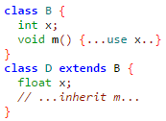
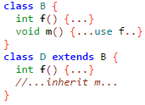
Overriding vs hiding (Java)
Hiding
Overriding

Slide 14
Method hiding in C#
In C#, the parent class has to allow overriding for a method via the virtual keyword. The subclass can override the method by using the override keyword. If no virtual keyword is present, method hiding occurs.
(HidingDemo C#)

Slide 15
Method overloading
A method that has the same name and return type but a different parameter list (different number or parameters or different type) from another method is considered overloaded.
e.g.
public int count(int limit){}
public int count(object limit){}
public int count(int limit, int offset){}

Slide 16
Method dispatch
Static dispatching: the method that will be called is determined at compile time.
Dynamic dispatching: the method that will be called is determined at run time.

Slide 17
Method dispatch
(BindingDemo)

Slide 18
Method dispatch
(BindingDemo2 – static method)

Slide 19
Method dispatch
(BindingDemo3 – Super overridden)

Slide 20
Method dispatch
(BindingDemo3 – Private method)

Slide 21
Method dispatch
(BindingDemo4 – Inner class)

Slide 22
Overriding instance fields
(BindingDemo5)

Slide 23
Overriding static fields
(BindingDemo6)

Slide 24
We have the following strategy implementation
What’s the problem with this design?

Slide 25
Template method pattern
We just implemented the template method pattern.
An abstract class is created with a concrete method and an abstract method. The concrete method calls the abstract method. The (concrete) subclasses of the abstract class implement that abstract method.
Similar purpose as strategy, but abstract classes offer more functionality than interfaces.

Slide 26
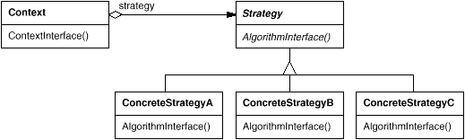
Strategy pattern
Put part of a method’s functionality in its own separate class

Slide 27
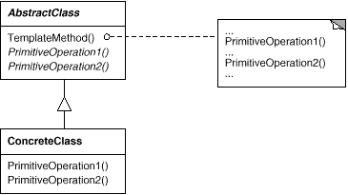
Template method pattern
Put part of a method’s functionality in a own subclass

Slide 28

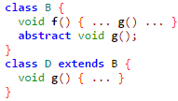
Template vs. Inheritance
Inheritance
Template

Slide 29
Types of classes
Interfaces (pure abstract class)
Concrete non-final class
No method bodies, No instance fields
May not be instantiated
Must be implemented to be useful
Required method bodies
May be instantiated
May be extended
Abstract class
Final class*
Optional method bodies
May not be instantiated
Must be extended to be useful (except class methods)
Required method bodies
May be instantiated
May not be extended

Slide 30
General rules of thumb
Always create an interface – even on top of an abstract class
Always prefer delegation (it won’t always make sense to do so)
Both of these allow for more flexibility.

Slide 31
Visio Demo

Slide 32
Project discussion

